Slide 1
Fall 2020
DATS 501 Fundamentals of Data Science
Hasan Demirtaş
hdemirtas.academic@gmail.com

Slide 2

Decision Theory

Slide 3
Idea
Minimizing the expected loss
Or
Maximizing the expected utility

Slide 4
Example1 (Minimizing the expected loss)
Electricity pole isolators length:
Loss function is linearly related with number of faults
Very long -> costly
Very short -> electric fault during rainy weather
Asssuming each fault costs 50-units money
 | Material cost | Fault | Fault cost | Total cost
Short | 100 | 5 | 250 | 350
Mid size | 200 | 1 | 50 | 250
Long | 300 | 0 | 0 | 300
Mid size is the plausible choice

Slide 5
Example2 (Maximizing the expected utility)
Investment in risky portfolios:
Loss function is square loss
Low risk -> low return & low bankrupt risk
High risk -> high return & high bankrupt risk
Asssuming bankrupt costs 1000-units money
 | Return | Bankrupt prob. | Bankrupt cost | Bankrupt utility | Total utility
Low risk | 100 | 0% | 0 | -0 | 100
Mid risk | 200 | 2% | 20 | -400 | -200
High risk | 300 | 3% | 30 | -900 | -600
Low risk is the plausible choice

Slide 6
Example3 (cost matrix for classification)
Spam classification:
y = 0 is not spam, y = 1 is spam
ŷ = 0 is not spam predicted, ŷ = 1 is spam predicted
utility | y = 0 | y = 1
ŷ = 0 | 1 | -10
ŷ = 1 | -100 | 2

Slide 7
Example4 (cost function for linear regression)
Deviation from real value penalty:
Loss function is order 2
y is the real target value
ŷ is the predicted target value
L = ( y – ŷ )^2

Slide 8
Cognitive Biases

Slide 9
Framing Effect
How information is framed (shown) affects our choices
Positive expressions are more effective on average human

Slide 10

Framing Effect
Advertisements generally focus on positive expressions

Slide 11
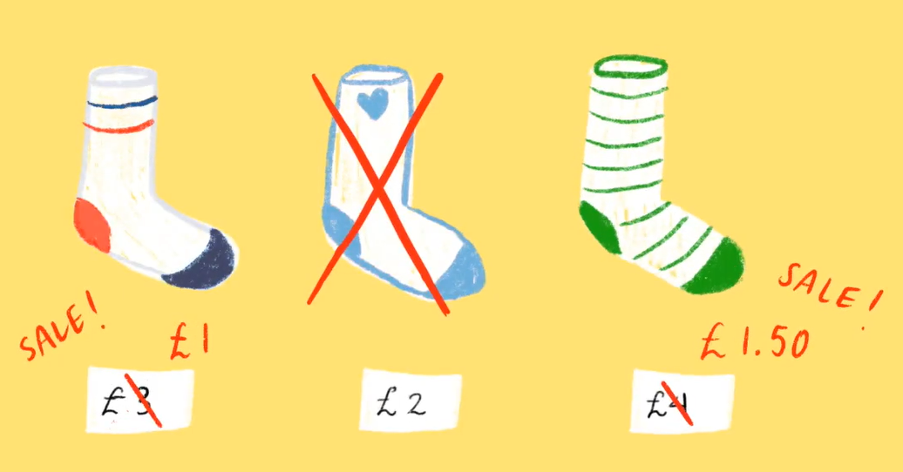
Framing Effect
Advertisements generally focus on positive expressions

Slide 12
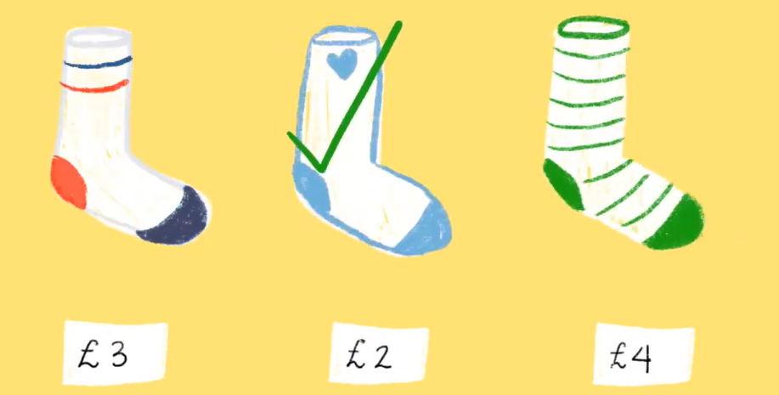
Framing Effect
Advertisements generally focus on positive expressions

Slide 13
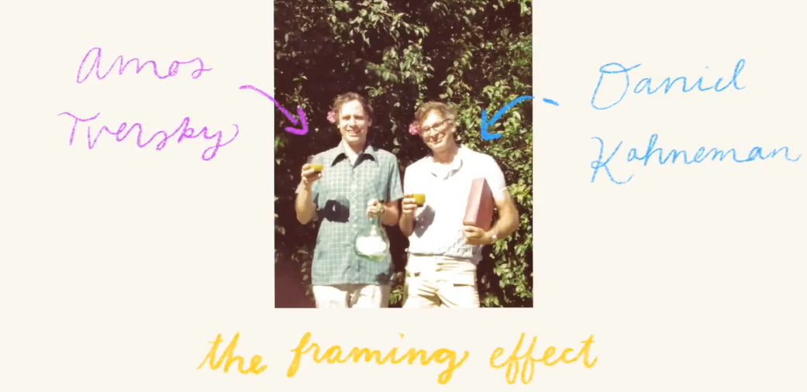
Framing Effect
Tversky & Kahneman

Slide 14
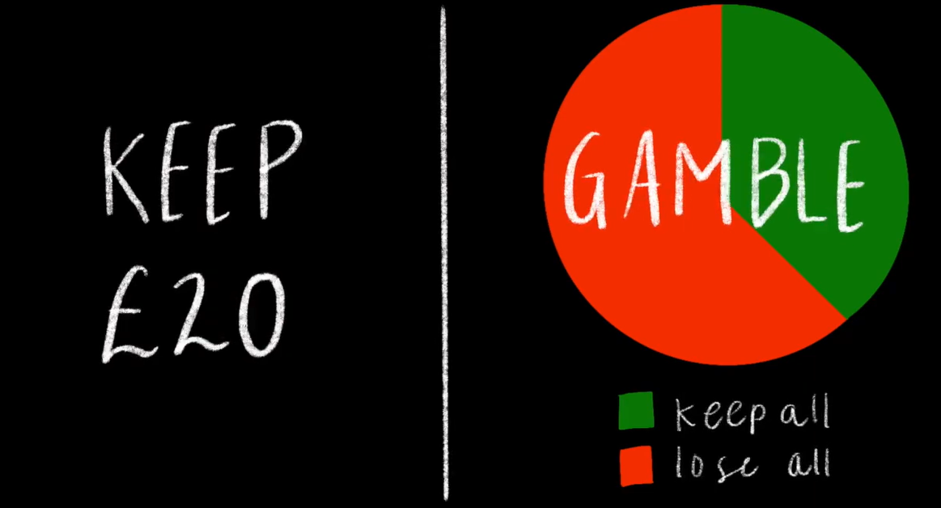
Framing Effect
You receive 50 euros

Slide 15
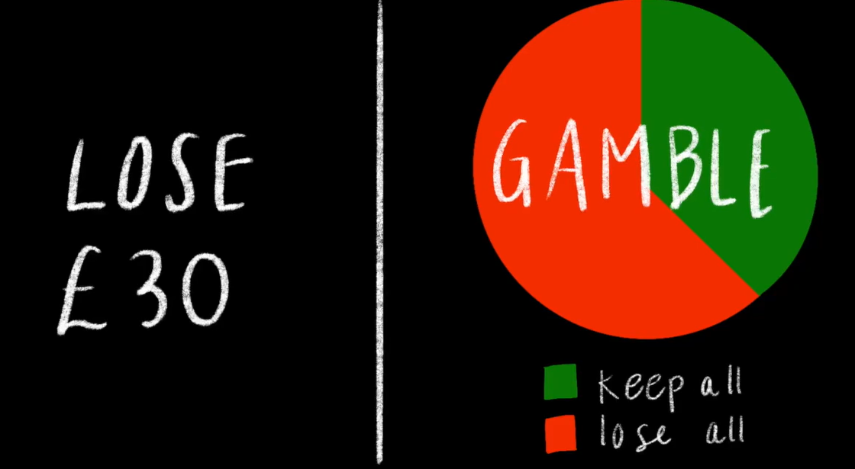
Framing Effect
You receive 50 euros

Slide 16
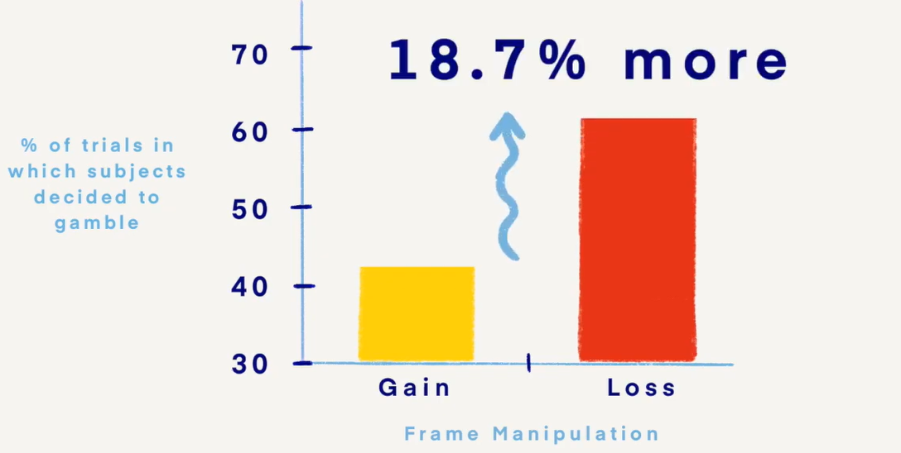
Framing Effect
Choice comparison

Slide 17
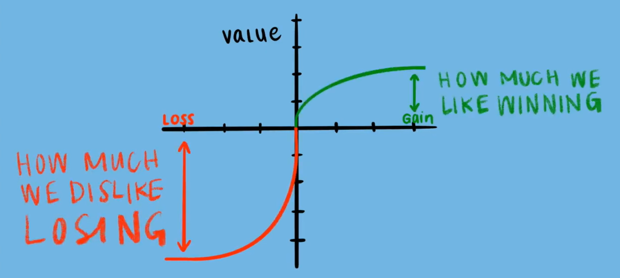
Framing Effect
Risk avert

Slide 18
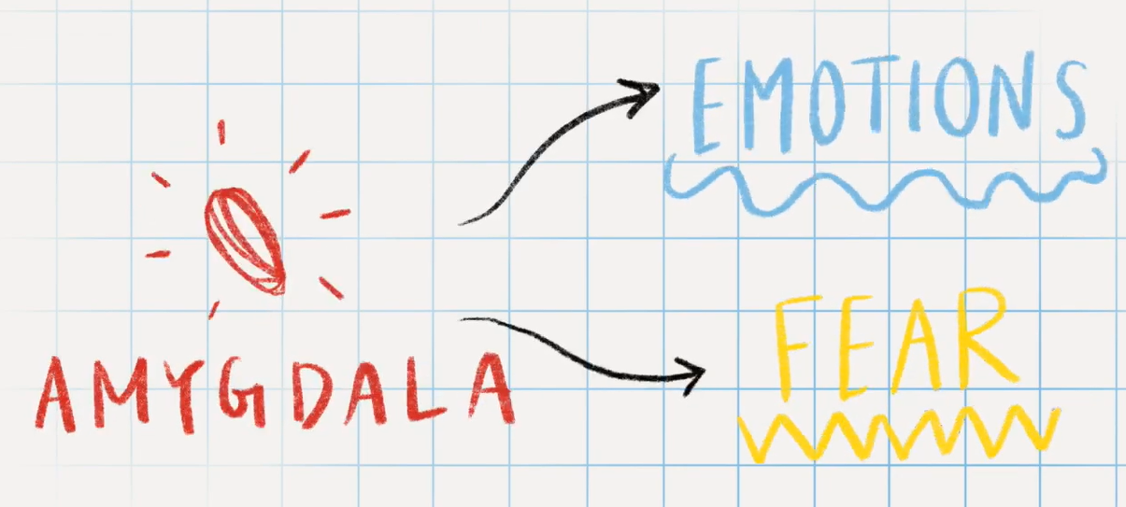
Framing Effect
Brain

Slide 19
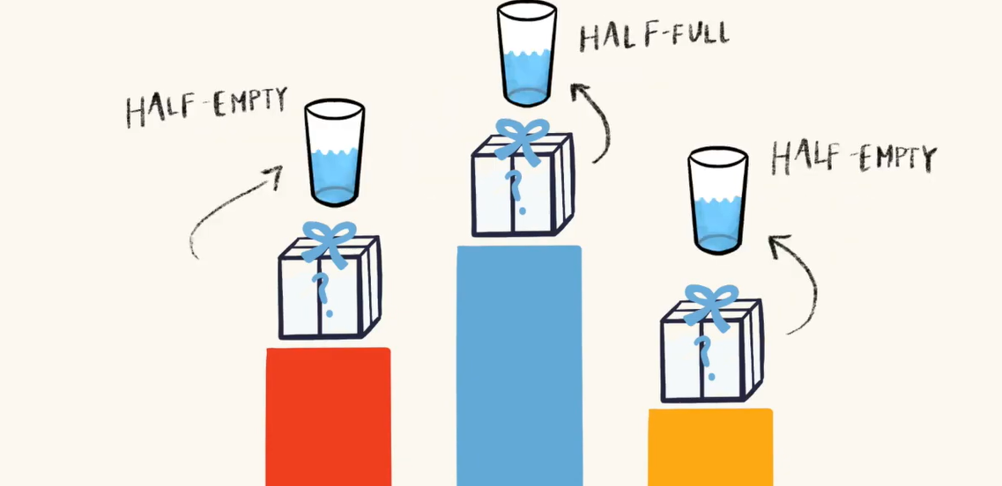
Framing Effect
Winner is the positive

